Slide 1
Week 2: Ethics in Data Science
Nga Than, Hunter College, Feb 03,2020

Slide 2
Announcements
CMS is hiring research assistants (interviewers)
Conduct semi-structured interviews
Pay: $20/hour + reimbursement for traveling

Slide 3
Summer School/ Workshops
ICPSR in Michigan is accepting application:
https://www.icpsr.umich.edu/icpsrweb/sumprog/
Schedule: https://www.icpsr.umich.edu/icpsrweb/content/sumprog/schedule.html
SICSS (main site: Duke Uni), and other global sites (Montreal, SF, Chicago):
https://compsocialscience.github.io/summer-institute/

Slide 4
Data Sources
Github Webpage: https://github.com/ngathan/DataMiningS2020

Slide 5
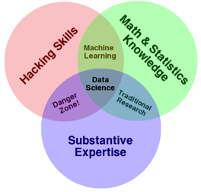
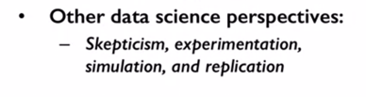
Drew Conway–Data Science

Slide 6
Data & Data Ethics
The above definition does not take into account the ethical dimension of data and data analysis
Data Analysis has a craft to it, as well as an ethical dimension.

Slide 7
Ethical Questions
What are stages of data analysis?
What is the difference between proprietary and open data formats?
What does it mean by high quality data? How do you get it?
Some ethical concerns with certain types of data.

Slide 8
What Constitutes Research Data?
"Material or information on which an argument, theory, test or hypothesis, or another research output is based." Queensland University of Technology. Manual of Procedures and Policies. Section 2.8.3. http://www.mopp.qut.edu.au/D/D_02_08.jsp

Slide 9
What Constitutes Research Data?
"What constitutes such data will be determined by the community of interest through the process of peer review and program management. This may include, but is not limited to: data, publications, samples, physical collections, software and models" Marieke Guy. http://www.slideshare.net/MariekeGuy/bridging-the-gap-between-researchers-and-research-data-management , #2

Slide 10
What Constitutes Research Data?
"Units of information created in the course of research" https://www.nsf.gov/bfa/dias/policy/dmpfaqs.jsp
"(i) Research data is defined as the recorded factual material commonly accepted in the scientific community as necessary to validate research findings, but not any of the following: preliminary analyses, drafts of scientific papers, plans for future research, peer reviews, or communications with colleagues." OMB-110, Subpart C, section 36, (d) (i), http://www.whitehouse.gov/omb/circulars_a110/

Slide 11
What Constitutes Research Data?
"The short answer is that we can’t always trust empirical measures at face value: data is always biased, measurements always contain errors, systems always have confounders, and people always make assumptions." Angela Bassa. https://medium.com/@angebassa/data-alone-isnt-ground-truth-9e733079dfd4
In summary, research data is: Material or information necessary to come to your conclusion.

Slide 12
Forms of data
Text data: Non-digital text (lab books, field notebooks), Digital texts or digital copies of text
Numeric Data: Spreadsheets, databases
Media Data: Audio, Video
Spatial Data: GIS
Matlab files & 3D Models
Computer code, Protein or genetic sequences

Slide 13
Your Experience?
What are some forms of data you use in your work?
What about forms of data that you produce as your output?
Perhaps there are some forms that are typical of your field?
Where do you usually get your data from?

Slide 14
Stages of Data - Raw
Raw data is yet to be processed, meaning it has yet to be manipulated by a human or computer.
But "raw data" is a relative term, inasmuch as when one person finishes processing data and presents it as a finished product, another person may take that product and work on it further, and for them that data is "raw data".
Is "big data" "raw data"? How do we understand digital trace data that we have "scraped"?

Slide 15
Stages of Data - Processed/Transformed
Processing data puts it into a state more readily available for analysis, and makes the data legible. For instance it could be rendered as structured data. This can also take many forms, e.g., a table.

Slide 16
Open-source vs. Proprietary
.csv vs .Xls/Xlsx
.docx vs. .txt
.Rdata vs. .dta/ .sav

Slide 17
Your Experience: Transforming Data
How do you decide the formats to store your data when you transition from 'raw' to 'processed/transformed' data?
What are some of your considerations?

Slide 18
Tidy Data Principles
There are guidelines to the processing of data, sometimes referred to as Tidy Data. One manifestation of these rules:
Each variable is in a column.
Each observation is a row.
Each value is a cell.

Slide 19
 | Thu 6
 | 12:00 PM – 1:00 PM | 1:00 PM – 2:00 PM | 2:00 PM – 3:00 PM
Angela Dunne |  |  | OK
Leigh Claire | OK | OK | OK
Nga Than |  |  | OK

Slide 20
Stages of Data: Cleaned
High quality data is measured in its validity, accuracy, completeness, consistency, and uniformity.

Slide 21
Processed data, even in a table, is going to be full of errors:
Empty fields
Multiple formats, such as "yes" or "y" or "1" for a positive response.
Suspect answers, like a date of birth of 00/11/1234
Impossible negative numbers, like an age of "-37"
Dubious outliers
Duplicated rows
And many more!
Cleaning data is the work of correcting the errors listed above, and moving towards high quality. This work can be done manually or programmatically.

Slide 22
Validity
Measurements must be valid, in that they must conform to set constraints:
The aforementioned "yes" or "y" or "1" should all be changed to one response.
Certain fields cannot be empty, or the whole observation must be thrown out.
Uniqueness, for instance no two people should have the same social security number.

Slide 23
Accuracy
Measurements must be accurate, in that they must represent the correct values. While an observation may be valid, it might at the same time be inaccurate. 123 Fake street is a valid, inaccurate street address. Unfortunately, accuracy is mostly achieved in the observation process. To be achieved in the cleaning process, an outside trusted source would have to be cross-referenced.

Slide 24
Completeness
Measurements must be complete, in that they must represent everything that might be known. This also is nearly impossible to achieve in the cleaning process! For instance in a survey, it would be necessary to re-interview someone whose previous answer to a question was left blank.
Consistency
Measurements must be consistent, in that different observations must not contradict each other. For instance, one person cannot be represented as both dead and still alive in different observations.

Slide 25
Uniformity
Measurements must be uniform, in that the same unit of measure must be used in all relevant measurements. If one person's height is listed in meters and another in feet, one measurement must be converted.

Slide 26
When do we stop cleaning?
How do we know when our data is cleaned enough? What happens to the data that is removed? What are we choosing to say about our dataset as we prepare them for analysis?

Slide 27
Stages of Data: Analyzed
Analysis can take many forms:
Descriptive Analysis
Inferential Analysis

Slide 28
Descriptive Analysis
Mean
Median
Mode
Average
Standard deviation

Slide 29
Inferential Analysis
Techniques geared towards testing a hypothesis about a population, based on your data set, such as:
Extrapolation (Predictive Analytics)
P-Value calculation (Testing Statistical Relationship)
Causal Inference (Fast growing field in ML)

Slide 30
Your experience with Data Analysis?
As we consider the types of analysis that we choose to apply onto our data set, what are we representing and leaving out?
How do we guide our decisions of interpretation with our choices of analyses?
Are we comfortable with the unintended use of our research?
What are potential misuses of our outputs?
What can happen when we are trying to just go for the next big thing (tool/methods/algorithms) or just ran out of time and/or budget for our project?

Slide 31
Stages of Data: Visualized
Comparisons
bar & line
side-by-side bars
dot plot
scatter plot
Small numbers/percentages
pie chart
tree map
waterfall
Time
dot plot
slope graph
line graph
sankey diagram
timeline

Slide 32
Visualized (Cont.)
Survey responses
bar chart
stacked bar
nested map

Slide 33
Your Experience: Visualization
What are we assuming when we choose to visually represent data in particular ways?
How can data visualization mislead us?

Slide 34

Is scraping public data legal and/or ethical?
Victory! Ruling in hiQ v. Linkedin Protects Scraping of Public Data

Slide 35
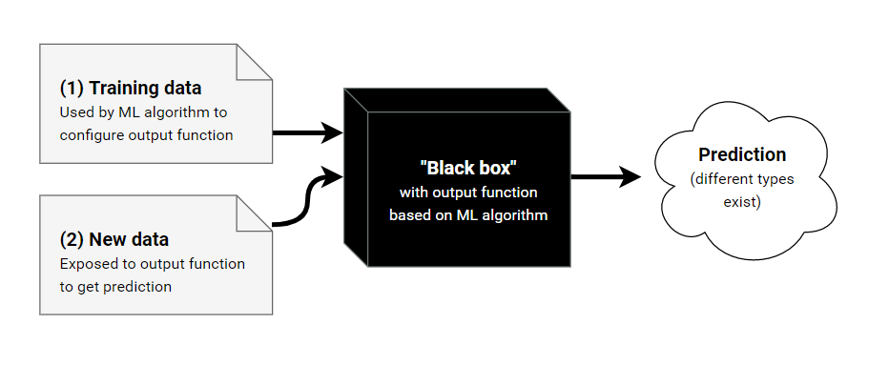
Machine Learning: Black-box

Slide 36
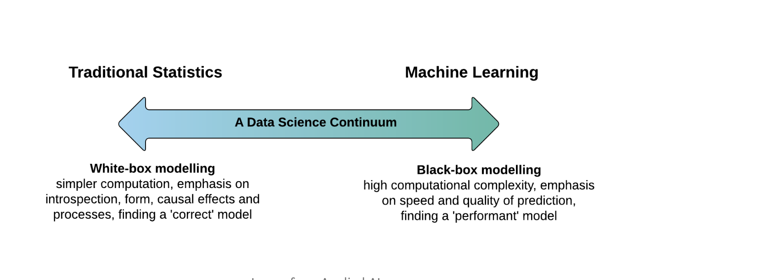

Slide 37
Implications of Black Box Problem
Social Scientists care about explainability
Black Box Nature of many machine learning techniques only work for prediction.
What can we do?
Should we not use ML? Or under what conditions can ML be used in Social Sciences?

Slide 38
5 mins break

Slide 39
Lab

Slide 40
Check List
R
RStudio
Slack
Github
Dropbox

Slide 41
Group Discussion
Case Study 1: Patreon and Hacked Data
Link: https://tinyurl.com/Patreon-case

Slide 42
Problem set 2 due in two weeks
Problem set 2 is due on Feb 10

Slide 43
Social Problem
Topic 1
Topic 2
Topic 3
Research Q1
Research Q2
Research Q3
Research Q4
Research Q5
Data 1
Data 2
Data 3
Data 4
Data 5

Slide 44
Brainstorming: Final Project Ideas
What are social problems you are interested in?
What are the topics of those problems do you want to examine further?
What are some research questions can you ask?
5 questions: what, where, when, how, WHY?
What factors contribute to the spread of misinformation about a coronavirus on social media?
What topics are prevalent on social media about this epidemic?

Slide 45
Social Problem: Online Hate Speech
What - Content
Who: Actors
Structure :Networks
What is the prevalence of hate speech on Youtube?
How often there is sexist comments directed to female Youtubers?
Who tends to use hate speech on Youtube?
How hate speech spreads?
What does hate-speech structure look like?
Youtube API
Youtube API
Youtube API
Youtube API
Youtube API

Slide 46
Feedback for Week 2
https://tinyurl.com/DM2020-W2

